Slide 1
Medical Image Synthesis
Exploring GANs in Medical Applications

Slide 2
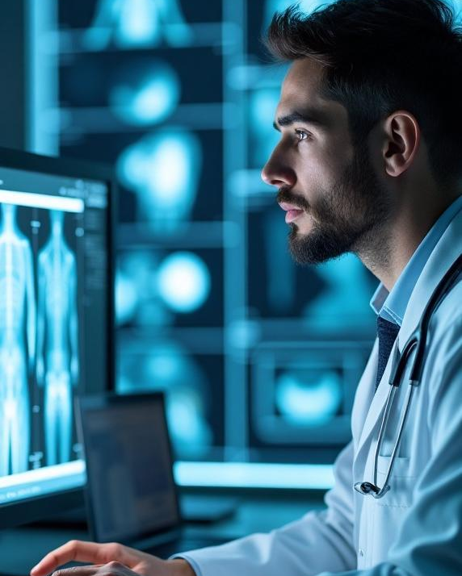
Introduction
The integration of Artificial Intelligence (AI) in healthcare has transformed medical practices.
Deep learning technologies enhance diagnostic precision, optimize treatment protocols, and tailor patient care.
Generative Adversarial Networks (GANs) play a crucial role in generating realistic medical images.
GANs address challenges posed by limited datasets and the necessity for high-quality synthetic data

Slide 3
01
AI in Healthcare

Slide 4
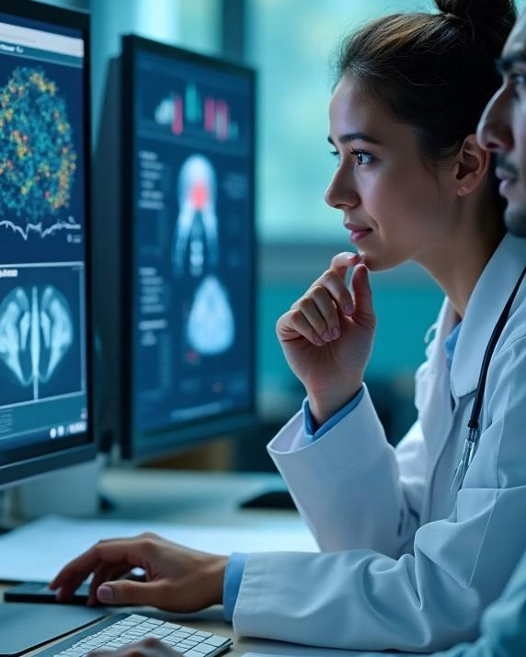
Role of AI in diagnostics
AI has revolutionized diagnostics by enabling more accurate disease detection.
AI predicts patient outcomes with greater precision.
AI personalizes treatment plans based on individual patient data.
Machine learning algorithms analyze vast datasets to uncover patterns often missed by human clinicians.

Slide 5
Deep learning technologies
Deep learning algorithms use neural networks with multiple layers to process complex data.
This approach enhances image analysis capabilities.
Significant advancements have been made in imaging diagnostics, pathology, and radiology.

Slide 6
Benefits of synthetic data
Synthetic data generated by GANs provides additional training resources for AI models.
This is particularly useful in medical imaging, where labeled data is scarce.
Synthetic data enhances model performance, reduces overfitting, and improves diagnostic accuracy.

Slide 7
02
GANs Overview

Slide 8
Mechanisms of GANs
GANs operate with two neural networks: the generator and the discriminator.
The generator creates synthetic images.
The discriminator evaluates the authenticity of the generated images.
This adversarial process continues until the generated images are indistinguishable from real ones.

Slide 9
Types of GANs
Various GAN architectures have been developed for specific applications in medical imaging.
Notable types include:
Deep Convolutional GANs (DCGANs): Optimized for high-quality image generation.
Conditional GANs (CGANs): Used for generating images based on specific conditions or labels.
StyleGANs: Designed to optimize image quality and diversity, particularly in generating highly realistic images.

Slide 10
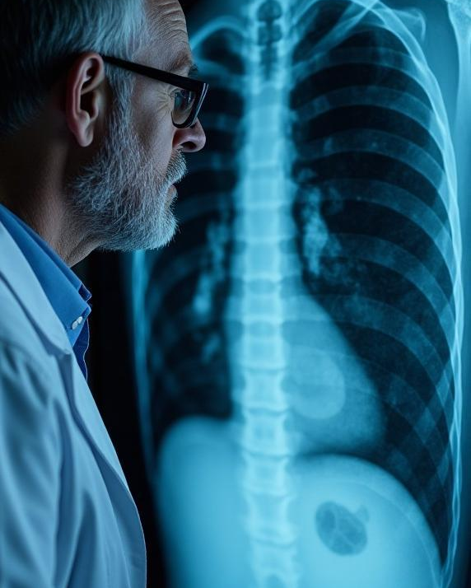
Comparison with traditional methods
Aspect | Traditional Methods | GANs (Generative Adversarial Networks)
Feature Learning | Relies on handcrafted features and rule-based algorithms | Automatically learns features from large datasets
Accuracy & Generalizability | Limited by handcrafted features and rules | Improves fidelity and applicability of synthetic images
Image Generation | Limited in generating realistic images | Generates highly realistic images for clinical applications
Clinical Applications | Less flexible for various applications | Can be applied across various clinical fields effectively

Slide 11
Applications in Medicine

Slide 12
Diagnosis of rare diseases
AI models enhanced by GANs, such as RareDxGPT, show promise in diagnosing rare diseases.
GANs synthesize relevant medical images to assist clinicians in recognizing unique patterns.
This capability bridges gaps in knowledge for rare diseases.
It improves diagnostic accuracy for conditions that might otherwise go undetected due to limited examples.

Slide 13
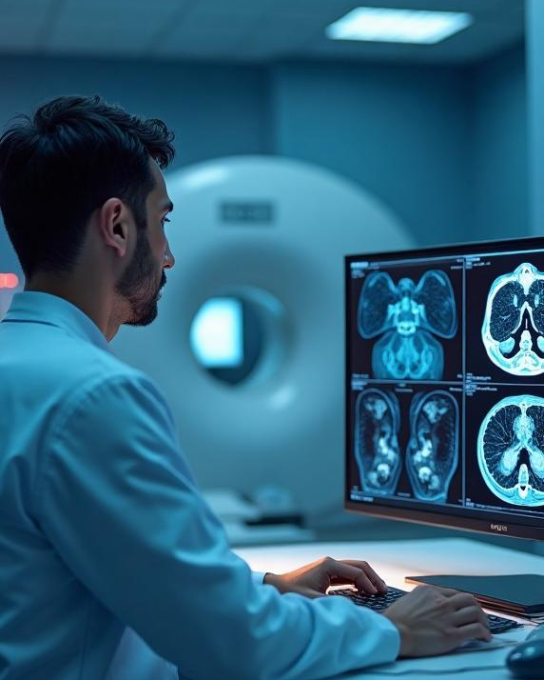
CT synthesis from MRI
GANs have been successfully applied to synthesize CT images from MRI data.
This technique accelerates imaging processes.
It minimizes exposure to radiation, reducing potential risks for patients.
GANs optimize treatment planning and allow for more informed decisions in radiation therapy.

Slide 14
Low-dose CT denoising
In radiology, GANs are used to enhance the quality of low-dose CT scans.
GANs reduce noise while preserving essential anatomical details.
The denoising process improves image clarity, aiding radiologists in diagnosis.
This approach eliminates the need for increased radiation doses, safeguarding patient health.

Slide 15
04
Challenges Ahead

Slide 16
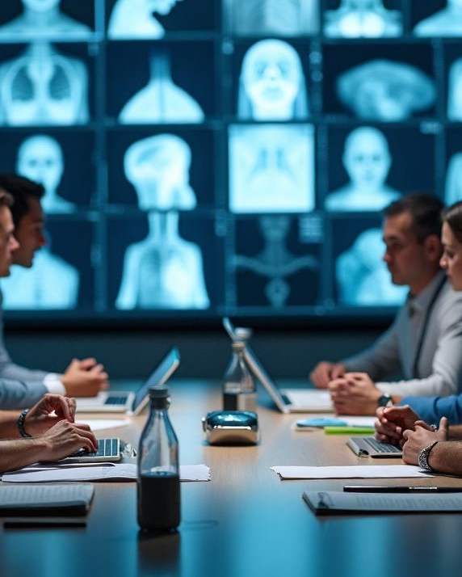
Need for clinical validation
The effectiveness of GAN-generated images in real-world clinical settings is still being evaluated.
Extensive clinical validation is crucial to assess their diagnostic utility.
Validation ensures that GAN-generated images meet the rigor required for patient care.

Slide 17
Ethical considerations
The implementation of GANs in clinical practice raises ethical concerns.
Key issues include:
Data privacy and protection.
Potential biases in generated data.
The need for transparent algorithms.
Addressing these ethical issues is crucial to maintain trust and ensure equity in patient treatment.

Slide 18
Future hybrid model development
Future advancements in GANs may involve hybrid models.
These models could integrate methods such as federated learning, enabling decentralized data usage.
Hybrid models would enhance interpretability, providing clearer insights into the decision-making process.
This could lead to improved models that generate high-quality images and explain the reasoning behind diagnoses.

Slide 19
Conclusions
In conclusion, GANs represent a significant advancement in the field of medical imaging, offering promising applications for enhancing diagnostics and treatment planning.
Nevertheless, further research and clinical validation are imperative to address existing challenges and harness the full potential of GANs for healthcare.

Slide 20
Thank you!
Do you have any questions?

